Slide 1
Sports injuries of the ankle
Based on 14th Edition of Campbell's operative Orthopedics
By Dr.hosseini
Autumn1402

Slide 2
Acute ligament injuries:
Sprains 85% (85% lateral inversion mechanism)
Risk factors:
height & weight & BMI
athletic activities (basketball)
Classification :
type I sprain (stretch)
type II sprain (incomplete ligamentous tears)
type III sprain (complete tear)
Ankle instability cause:
fracture or ligamentous injury or combination of both
talar shift (Maisonneuve fracture)

Slide 3
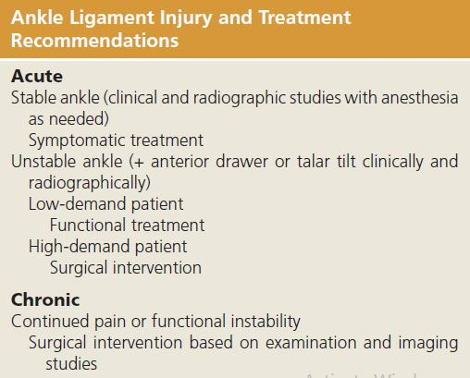
Practical approach:
stability of the ankles (stress tests)
patients functional level

Slide 4
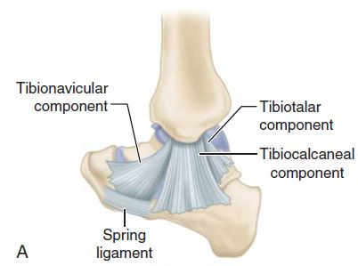
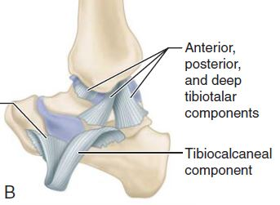
Anatomy:
Medial side:
Superficial deltoid:
Ant: tibionavicular
Mid: tibiocalcaneal
Post: tibiotalar
Deep deltoid:(most important)
Anterior deep tibiotalar
Posterior deep tibiotalar (strongest)
Intraarticular but extrasynovial
Resistance:
valgus tilting & lat&ant.translation

Slide 5
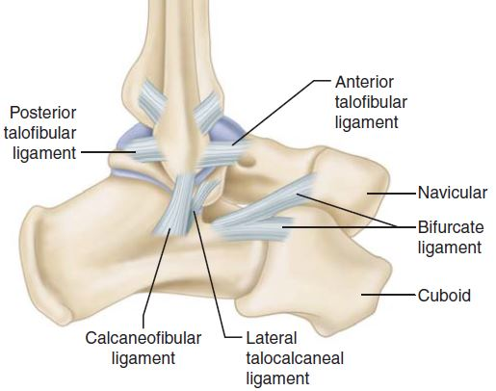
Lateral side:
ATFL:
weakest
resist ant.translation
CFL:
Extra capsular
PTFL (strongest):

Slide 6
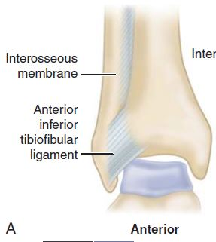
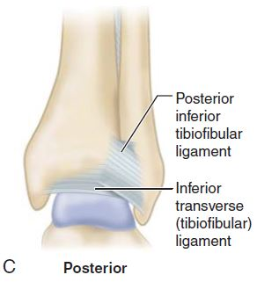
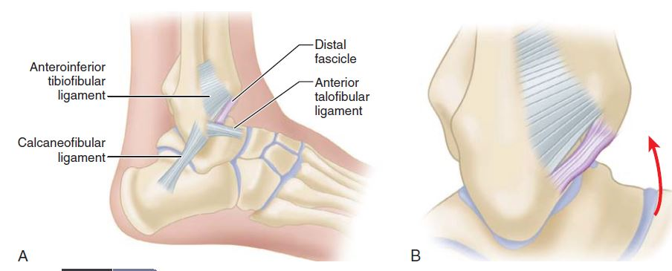
Syndesmosis:
AITFL:
Bassett’s ligament
PITFL:
Strongest
Inf.transverse TFL
IOL:

Slide 7
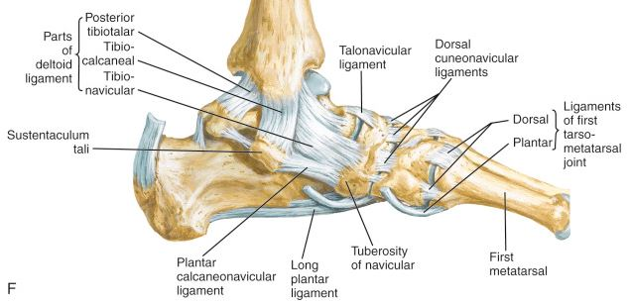
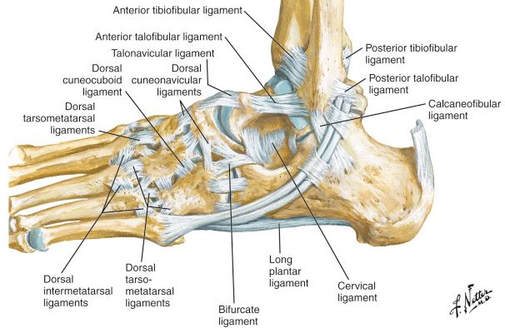
Diagnosis:
Physical examination:
palpation
100% diagnostic grade III , 25% grade II
Acute? Chronic?
more accurate after 5days
regional block. Injection in peroneal sheath
Stress tests

Slide 8
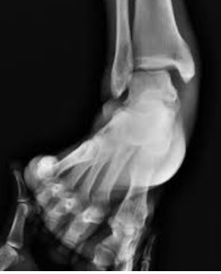
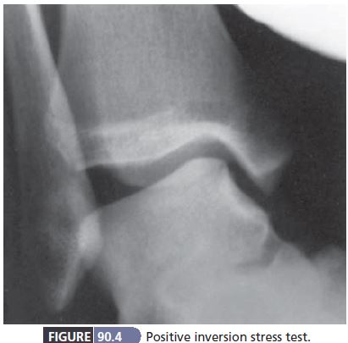

Inversion & eversion stress tests:
Deltoid rupture:
talus shift laterally with eversion stress
Syndesmosis injury + NL mortis
deltoid incompetence + lat.maleol Fx
Ext.rotation stress radiography (SER)
lateral ligaments disrupt:
Inversion stress (ankle plantar flex)
15^ talus tilt ATFL
15 to 30^ ATFL+ CFL
30^< ATFL+CFL+PTFL
$≢$cut off point
Both ankles stress test:
>10^ significant lateral ligamentous injury

Slide 9
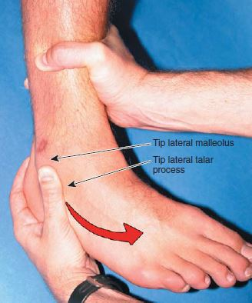
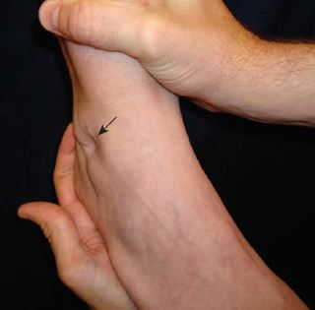
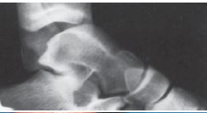
Anterior drawer sign:
Ant.post stress test
ATFL
sulcus sign
Subtalar sprain:
negative stress tests
chronic functional instability

Slide 10
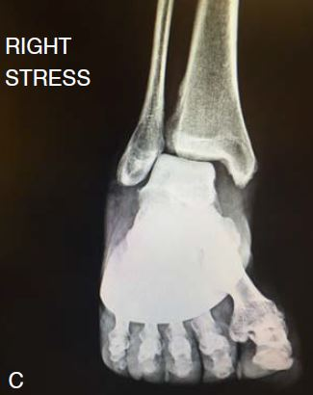
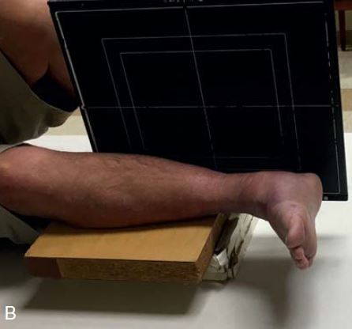
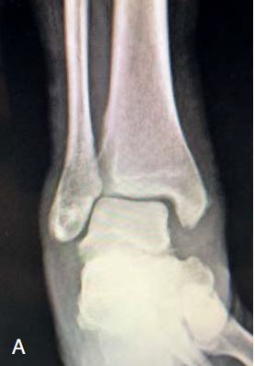
Stress view of the ankle mortise:
Syndesmotic injuries
Gravity stress view
manual external rotation stress view

Slide 11
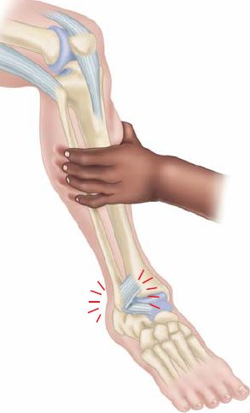
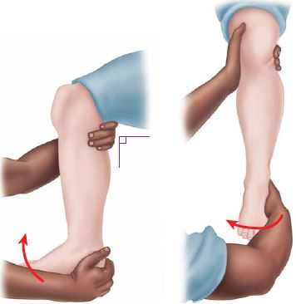

Compression (squeez) test:
other injuries should be R/O (examination & X-ray)
compressing fibula to tibia above midpoint of calf
Positive: distal pain in IOL
External rotation stress:
knee 90$°$ of flexion
ankle neutral position
Positive: pain over AITFL/PITFL/IOL

Slide 12
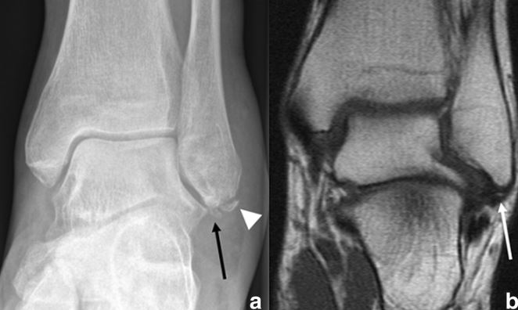

No need to be obtained routinely
“Functional” treatment
rest, ice, compression, elevation (RICE)
semi rigid brace
early ROM exercises
Os subfibulare
$±$ associated with laxity of the ATFL
Indications:
Recurrent inversion sprains
continuous discomfort
Movement of the os subfibulare

Slide 13
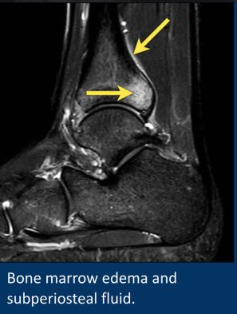
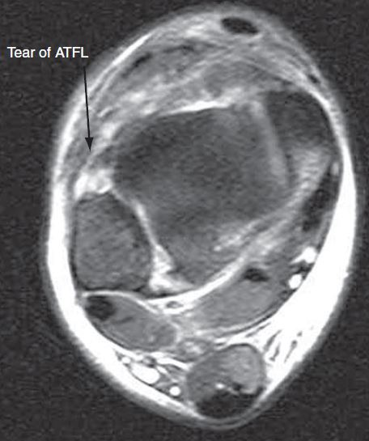
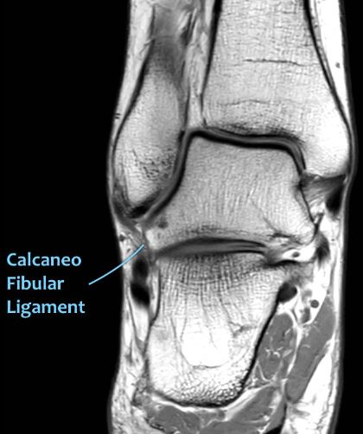
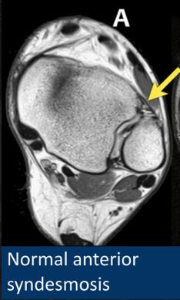

MRI:
Bone bruise (8.4 w)
Syndesmotic injuries
ATFL
PTFL
Deep deltoid
CFL
Peroneal
Cost $≠$ Benefit

Slide 14
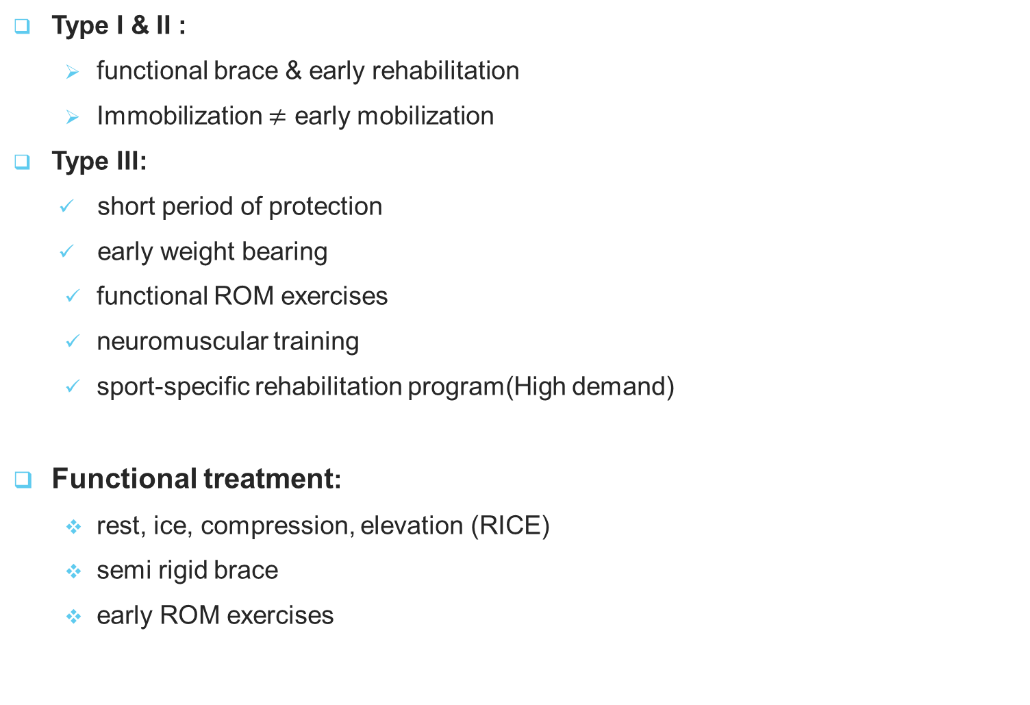
Treatment:
Type I & II :
functional brace & early rehabilitation
Immobilization $≠$ early mobilization
Type III:
short period of protection
early weight bearing
functional ROM exercises
neuromuscular training
sport-specific rehabilitation program(High demand)
Functional treatment:
rest, ice, compression, elevation (RICE)
semi rigid brace
early ROM exercises

Slide 15
Indications for surgical treatment:
large bony avulsions
unstable osteochondral injuries
severe ligamentous incompetence (med or lat side)
recurrent ankle injuries
Acute or Secondary or Delayed repair or reconstruction (years)?
Acute surgical intervention:
high-demand patients:
clinical and radiographic instability
may improve long-term results
Goal of treatment:
prevent chronic instability of the ankle

Slide 16
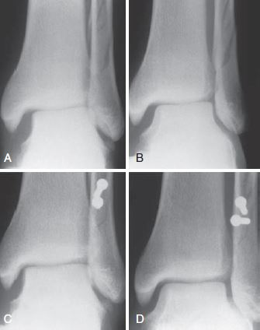
Acute deltoid ligament rupture:
Active patient:
Abnormal talus tilt or shift (mortise)
DDx:
isolated T.post rupture
medial ankle pain in pronation
Tendon entrapment
Isolated complete disruption:(rare)
below-knee cast for 4 to 6 weeks
Orthosis for 4 to 6 months
Enfold Ø
Lat.malleolus or syndesmotic :
surgical reduction until bone repair
Medial clear space < 4mm
without deltoid repair

Slide 17
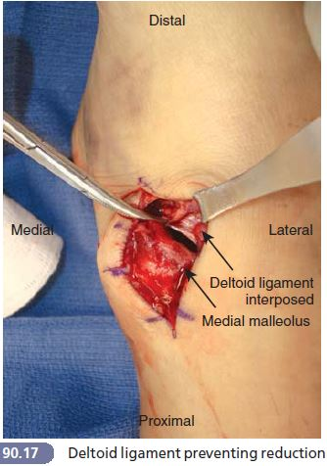

Acute distal tibiafibula ligament ruptures:
Associated injury:
Med.malleolus or proximal.fibula or both Fx
Deltoid rupture
Isolated syndesmotic injury:
Diastasis is rare
CR+cast
mortise widening after manipulation? surgery
Outcome ORIF>CRIF>CR
Mortise dislocated or significantly subluxed:
Med.approach to joint
$±$Repair deltoid ligament

Slide 18
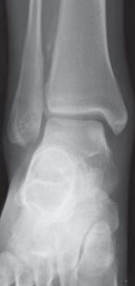
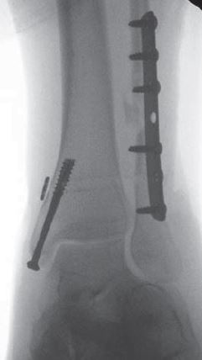
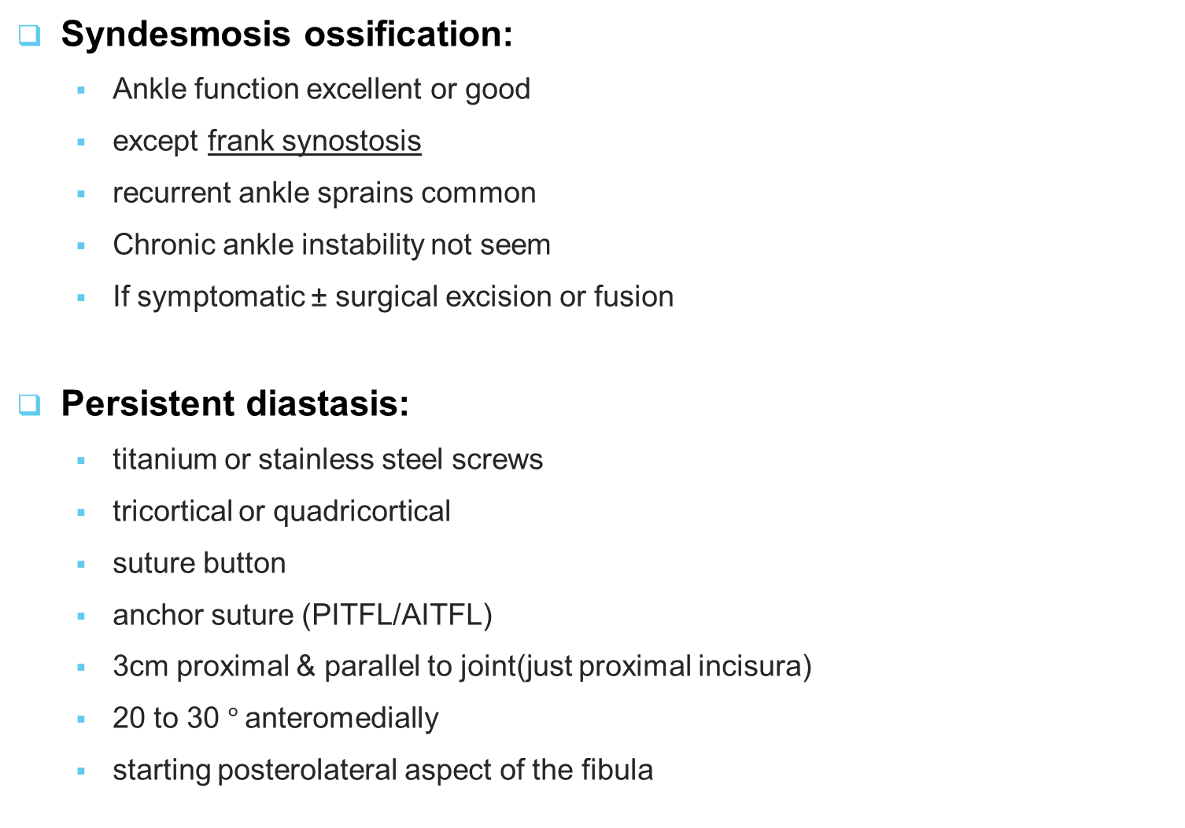
Syndesmosis ossification:
Ankle function excellent or good
except frank synostosis
recurrent ankle sprains common
Chronic ankle instability not seem
If symptomatic ± surgical excision or fusion
Persistent diastasis:
titanium or stainless steel screws
tricortical or quadricortical
suture button
anchor suture (PITFL/AITFL)
3cm proximal & parallel to joint(just proximal incisura)
20 to 30 $°$anteromedially
starting posterolateral aspect of the fibula

Slide 19
Hardware removal: (common)
50% of screws & 10% of suture buttons
before FWB (screw) , 3 to 4 months
Suture button fixation:
active individuals
earlier weight bearing
Less need for routine implant removal
Not rigid fixation:
may fibula healing slightly shorter
spontaneous reduction (even if there is mild initial malreduction)
Not recommend:
when the fibular fx is not rigidly fixed (Maisonneuve fractures)

Slide 20
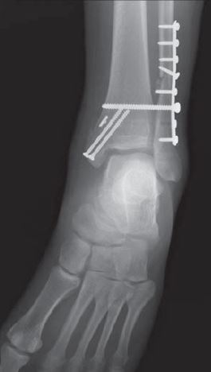
Postoperative care:
SLS for 2weeks
SLC for next 3weeks
5th ;walking boot toe touch WB / ROM exercises
8th_10th ; weight bearing in the boot start
use boot until 14th weeks (screw removal time)
Then FBW

Slide 21
Acute lateral ligaments ruptures:
Isolated ATFL rupture:
most important ankle stabilizing ligament
treated by immobilization
After healing ATFL: (full activity):
Residual symptom (lat.pain & swelling):
localized synovitis, painful scar in the ligament
peroneal muscle weakness
proprioceptive deficit nerves joint
Articular cartilage lesions
Intraarticular chondral lesions:
> ½ articular cartilage thickness
> 5 mm diameter
associated with postoperative pain

Slide 22
ATFL+CFL rupture:
subtalar joint kinematics(CFL)
support surgical repair
especially in young athletic
0ne study(388):
surgically treated group reduced :
giving way
recurrent sprains
residual pain
No difference in swelling, subjective outcome, return to sports
Not recommend routine primary repair for lateral ankle ligaments

Slide 23
Conservative treatment:
Functional treatment
Broström procedure:
capsular reefing or repair ATFL & CFL
mobilization & reattachment:
lat.portion ext.retinaculum to tip of fibula
If:
hyperlaxity
weigh > 240 lb
Anchor suture augmentation over the primary repair

Slide 24
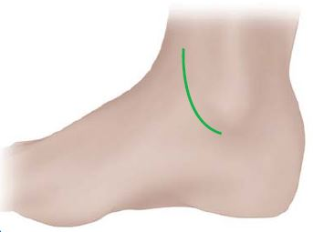
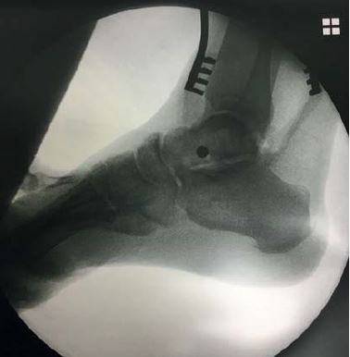
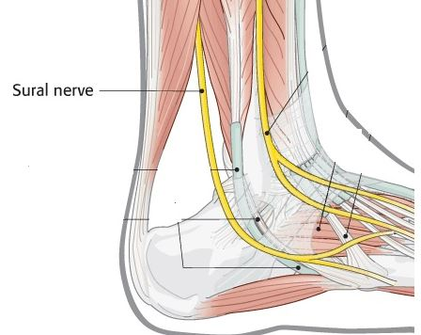
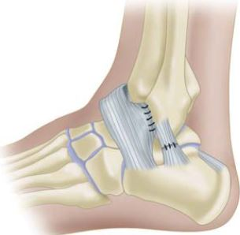
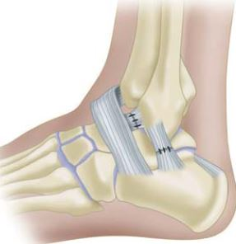

Brostorm procedure:
superficial peroneal & sural nerve
ext.retinaculum
Postoperative care:
0-2weeks ; NWB , SLS (neutral position,mildly evert)
2 weeks ; toe touch ,walking boot , sutures off , gentle ROM (inversion$⊘$)
5 weeks ; FWB , resistive exercises to gain eversion strength
8 weeks ; Inversion

Slide 25
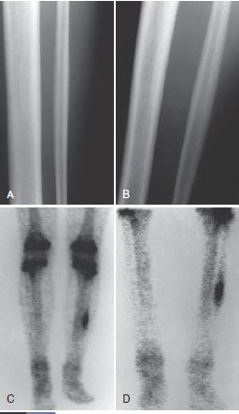
Chronic instability after injury:
Conservative treatment:
Broadening &lowering heel shoe(women)
lat.wedge heel (men)
high-top shoes
semirigid orthosis
Muscle power (PT for several months)
Other causes (R/O)

Slide 26
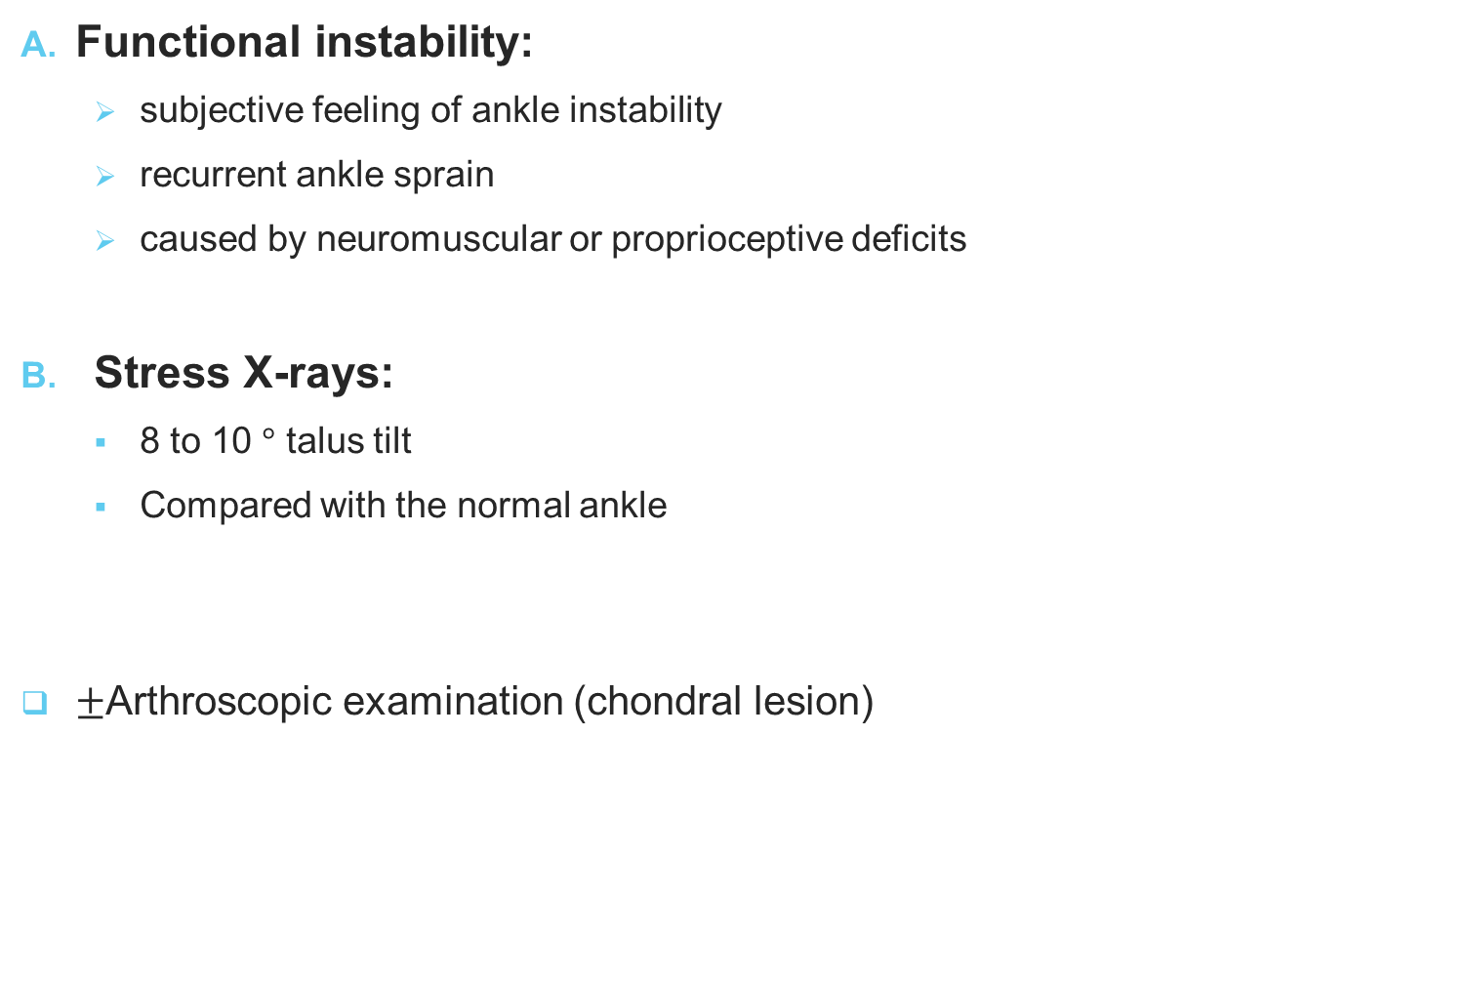
Chronic ankle instability?
Functional instability:
subjective feeling of ankle instability
recurrent ankle sprain
caused by neuromuscular or proprioceptive deficits
Stress X-rays:
8 to 10 $°$ talus tilt
Compared with the normal ankle
$±$Arthroscopic examination (chondral lesion)

Slide 27
Watson-Jones technique:
peroneus brevis tendon
reconstruct ATFL+CFL
Disadvantages:
Talus neck tunnel
Size peroneus brevis
Subtalar instability (oblique angle to the original fibers CFL)

Slide 28
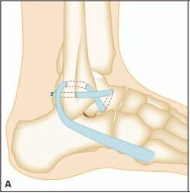
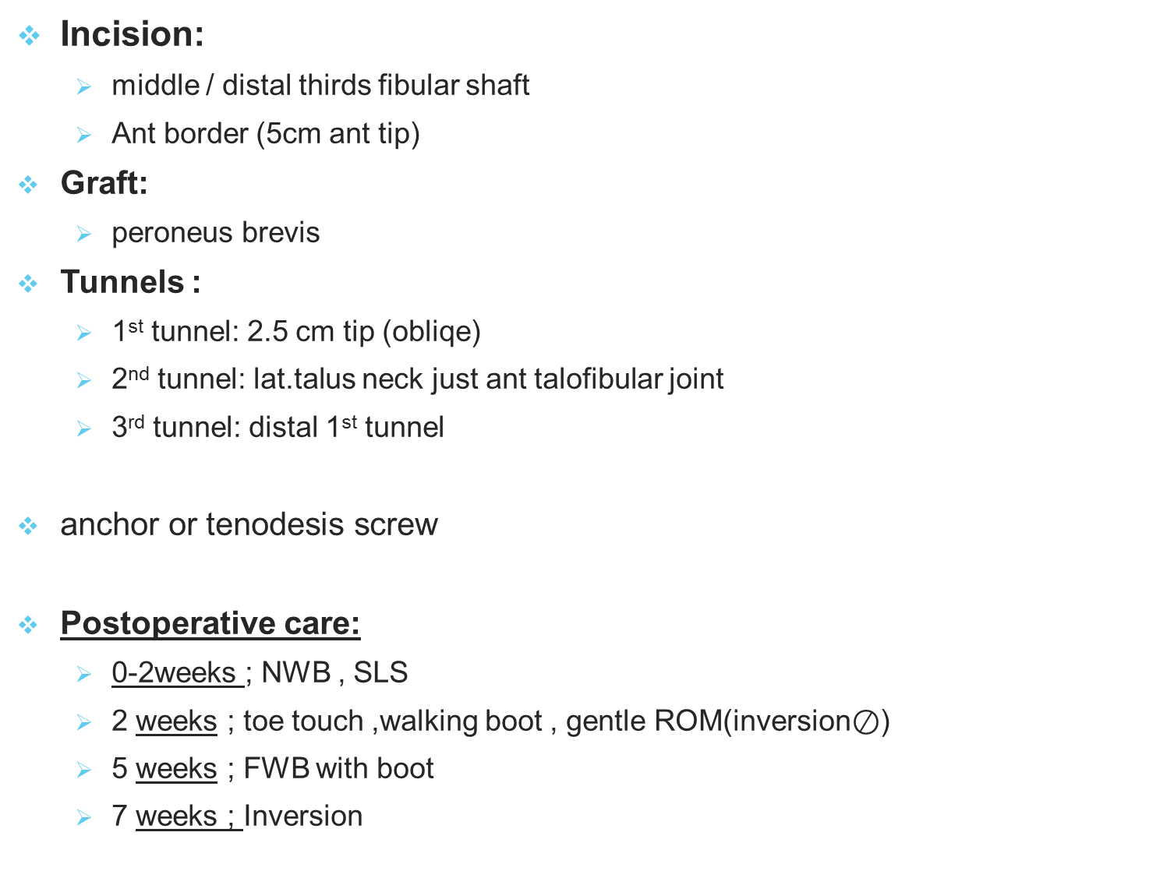
Incision:
middle / distal thirds fibular shaft
Ant border (5cm ant tip)
Graft:
peroneus brevis
Tunnels :
1st tunnel: 2.5 cm tip (obliqe)
2nd tunnel: lat.talus neck just ant talofibular joint
3rd tunnel: distal 1st tunnel
anchor or tenodesis screw
Postoperative care:
0-2weeks ; NWB , SLS
2 weeks ; toe touch ,walking boot , gentle ROM(inversion$⊘$)
5 weeks ; FWB with boot
7 weeks ; Inversion

Slide 29
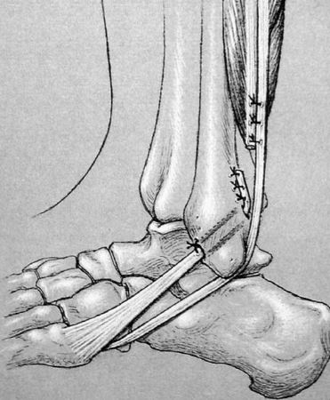
Evans technique:
Only CFL
Incision:
middle / distal thirds fibular shaft
Posterior border
To 5th metatarsal (sural nerve)
Graft:
anterior half (split)of the peroneus brevis
Tunnel:
Tip to 3.2 cm to tip
Tenodesis screw or suture
Postoperative care:
Similar to Watson-Jones technique
only if anatomic reconstruction of the lateral ankle ligaments is not feasible

Slide 30
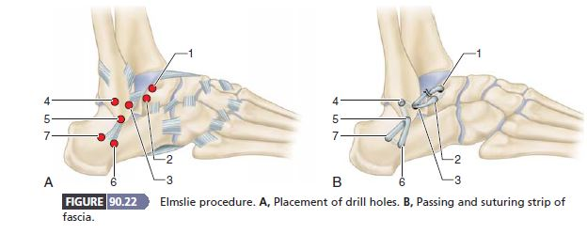
Modified Elmslie (Chrisman and Snook):
enhance lateral ankle and subtalar stability
half of the peroneus brevis tendon
ATFL+CFL

Slide 31
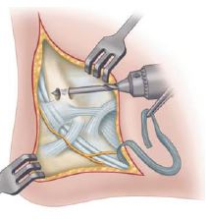
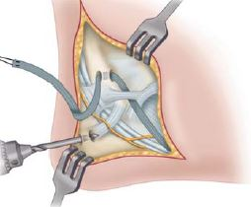

Incision:
Same Evans
Graft:
Split (from insertion upward ) peroneus brevis
semitendinosus or gracilis or allograft
Tunnel:
tenodesis screw or suture
Postoperative care:
Similar to Watson-Jones technique

Slide 32
Comparison of procedures:
Watson-Jones and Evans:
long-term clinical reasults were similar
controlled talar tilt:
Evans > Watson-Jones
AP instability:
Evans < Watson-Jones

Slide 33

modified Brostorm procedure
Choice
Reserve tendon augmentation:
Hypermobility
long-standing ligamentous insufficiency,
high BMI (usually >240 lb)
salvage procedure
failed modified Broström procedure
third to half of the peroneus brevis

Slide 34
modified Broström:
Disadvantages:
Surgical exposure was greater
Longer operation time
Benefit:
Less anterior talar displacement
less talar tilt angle
Greatest mechanical strength

